Slide 1

Analysis of Algorithm
Lecture 7
By
Huma Ayub

Slide 2
AVL Search Trees
What is an AVL Tree?
AVL Tree Implementation.
Why AVL Trees?
Rotations.

Slide 3
What is an AVL Tree?
An AVL tree is a binary search tree with a height balance property:
For each node v, the heights of the subtrees of v differ by at most 1.
A subtree of an AVL tree is also an AVL tree.
For each node of an AVL tree:
Balance factor = height(right subtree) - height(left subtree)
Balance factor = height(left subtree) - height(right subtree)
An AVL node can have a balance factor of -1, 0, or +1.
7
-1
7
-1
-1
1
-2
1
3
10
3
10
1
1
4
0
13
0
1
1
13
0
AVL Tree
Not an AVL Tree
2
0
2
0

Slide 4
Why AVL Trees?
Insertion or deletion in an ordinary Binary Search Tree can cause large imbalances.
In the worst case searching an imbalanced Binary Search Tree is O(n).
An AVL tree is rebalanced after each insertion or deletion.
The height-balance property ensures that the height of an AVL tree with n nodes is O(log n).
Searching, insertion, and deletion are all O(log n).

Slide 5
Rebalancing
Suppose the node to be rebalanced is X. There are 4 cases that we might have to fix (two are the mirror images of the other two):
An insertion in the left subtree of the left child of X,
An insertion in the right subtree of the left child of X,
An insertion in the left subtree of the right child of X, or
An insertion in the right subtree of the right child of X.
Balance is restored by tree rotations.

Slide 6
What is a Rotation?
A rotation is a process of switching children and parents among two or three adjacent nodes to restore balance to a tree.
An insertion or deletion may cause an imbalance in an AVL tree.
The deepest node, which is an ancestor of a deleted or an inserted node, and whose balance factor has changed to -2 or +2 requires rotation to rebalance the tree.
50
-1
-2
50
Insert 35
-1
45
78
0
-2
45
78
0
0
40
-1
40
0
Deepest unbalanced node
35

Slide 7
What is a Rotation? (contd.)
-2
-1
50
50
rotation
-2
45
78
0
0
40
78
0
-1
40
0
35
45
0
0
35
There are two kinds of single rotation:
Right Rotation. Left Rotation.
A double right-left rotation is a right rotation followed by a left rotation.
A double left-right rotation is a left rotation followed by a right rotation.

Slide 8
Single Right Rotation
Single right rotation:
The left child x of a node y becomes y's parent.
y becomes the right child of x.
The right child T₂ of x, if any, becomes the left child of y.
deepest unbalanced node
a right rotation of x about y
y
x
T₃
x
T₁
y
T₂
T₁
T₂
T₃
Note: The pivot of the rotation is the deepest unbalanced node

Slide 9
Single Left Rotation
Single left rotation:
The right child y of a node x becomes x's parent.
x becomes the left child of y.
The left child T₂ of y, if any, becomes the right child of x.
deepest unbalanced node
a left rotation of y about x
x
y
T₁
y
T₃
x
T₂
T₃
T₂
T₁
Note: The pivot of the rotation is the deepest unbalanced node

Slide 10
Single Rotation
A single rotation switches the roles of the parent and child while maintaining the search order.
Single rotation handles the outside cases (i.e. 1 and 4).i.e
1: An insertion in the left subtree of the left child of X,
4: An insertion in the right subtree of the right child of X.
We rotate between a node and its child.
Child becomes parent. Parent becomes right child in case 1, left child in case 4.
The result is a binary search tree that satisfies the AVL property.

Slide 11
Double Rotation
Single rotation does not fix the inside cases (2 and 3).
2. An insertion in the right subtree of the left child of X,
3. An insertion in the left subtree of the right child of X,
These cases require a double rotation

Slide 12
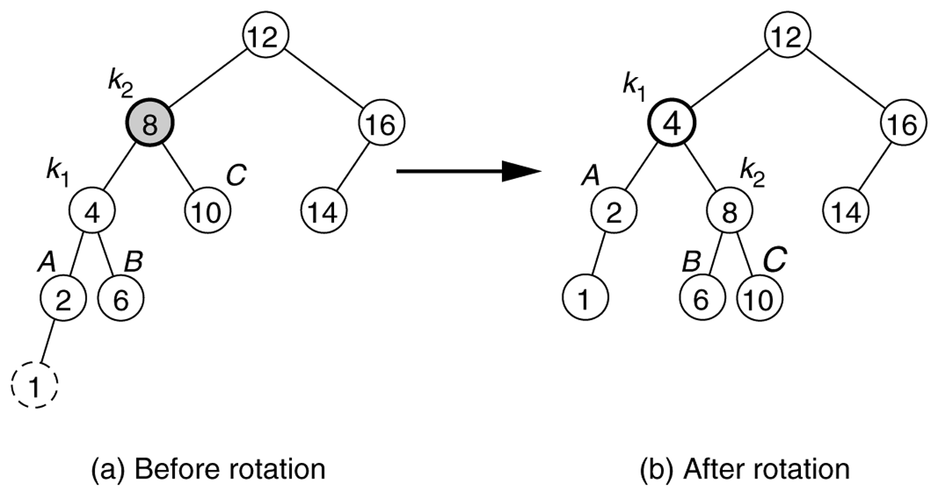
Figure 19.25
Single rotation fixes an AVL tree after insertion of 1.

Slide 13
Example : Start with an empty AVL tree and insert the items 3,2,1, and then 4 through 7 in sequential order.

Slide 14
Example
Start with an empty AVL tree and insert the items 3,2,1, and then 4 through 7 in sequential order.
Answer:
4
2
6
1
3
5
7

Slide 15
Insertion in an AVL tree
Let us call the node that must be rebalanced α
Since any node has at most 2 children, and a height imbalance requires that α’s 2 subtrees’ height differ by 2, there are 4 violation cases:
An insertion into the left subtree of the left child of α.
2) An insertion into the right subtree of the left child of α.
3) An insertion into the left subtree of the right child of α.
4) An insertion into the right subtree of the right child of α.
α
α
α
α

Slide 16
Insertion in an AVL tree
Outside cases (left-left or right-right), fixed by a single rotation:
An insertion into the left subtree of the left child of α.
4) An insertion into the right subtree of the right child of α.
6
6
α
2
8
2
7
α
1
5
7
8
9
4
3

Slide 17
Insertion in an AVL tree
Inside cases (right-left or left-right), fixed by a double rotation:
2) An insertion into the right subtree of the left child of α.
3) An insertion into the left subtree of the right child of α.
7
6
α
2
9
2
7
α
1
6
8
9
8
4
5

Slide 18
Double Right-Left Rotation
x
deepest unbalanced node
x
z
right rotation of y about z
y
T₁
T₁
y
T₄
T₂
z
T₂
T₃
T₃
T₄
y
left rotation of Y about X
Note: First pivot is the right child of the deepest unbalanced node; second pivot is the deepest unbalanced node
x
z
T₁
T₂
T₃
T₄

Slide 19
Double Left-Right Rotation
x
deepest unbalanced node
x
v
w
left rotation of w about v
T₄
T₄
T₁
w
T₃
v
T₂
T₃
T₂
T₁
w
left rotation of W about X
Note: First pivot is the left child of the deepest unbalanced node; second pivot is the deepest unbalanced node
v
x
T₁
T₂
T₃
T₄

Slide 20
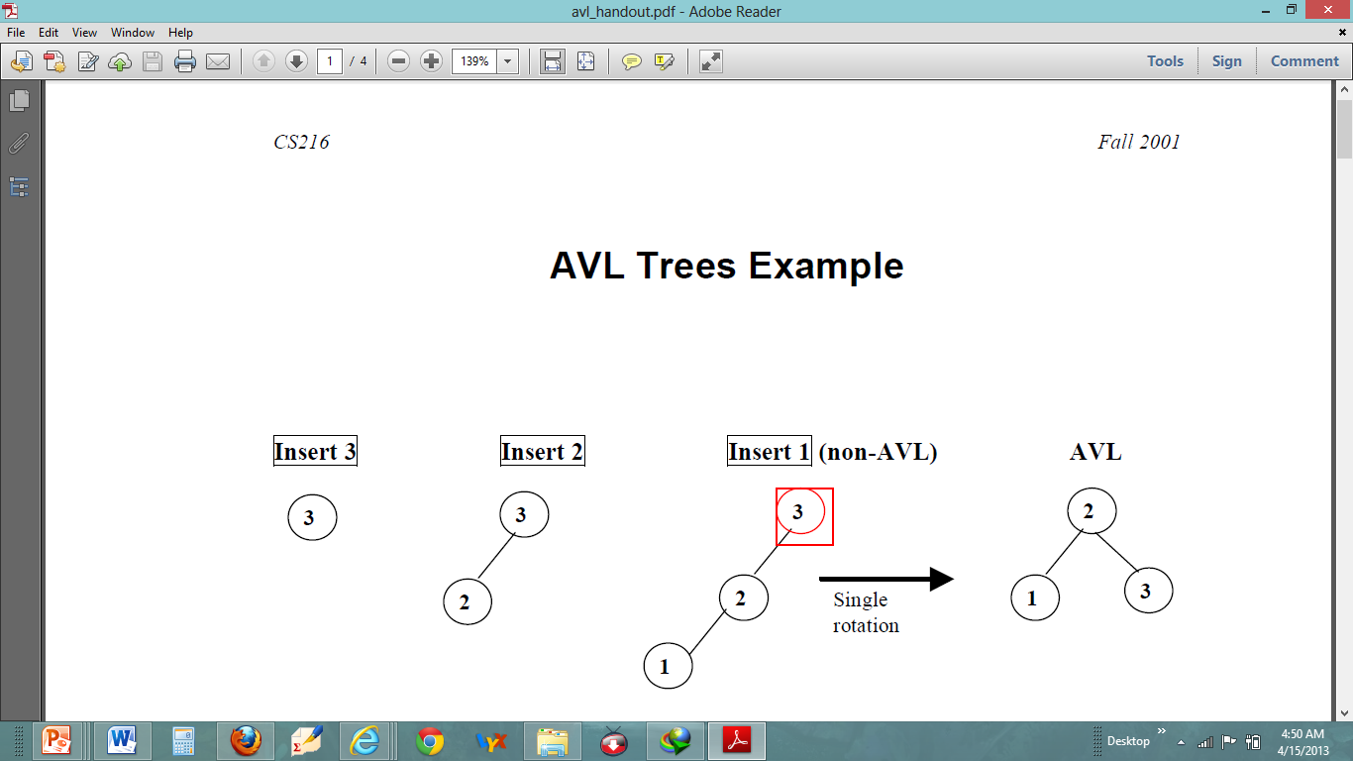

Slide 21
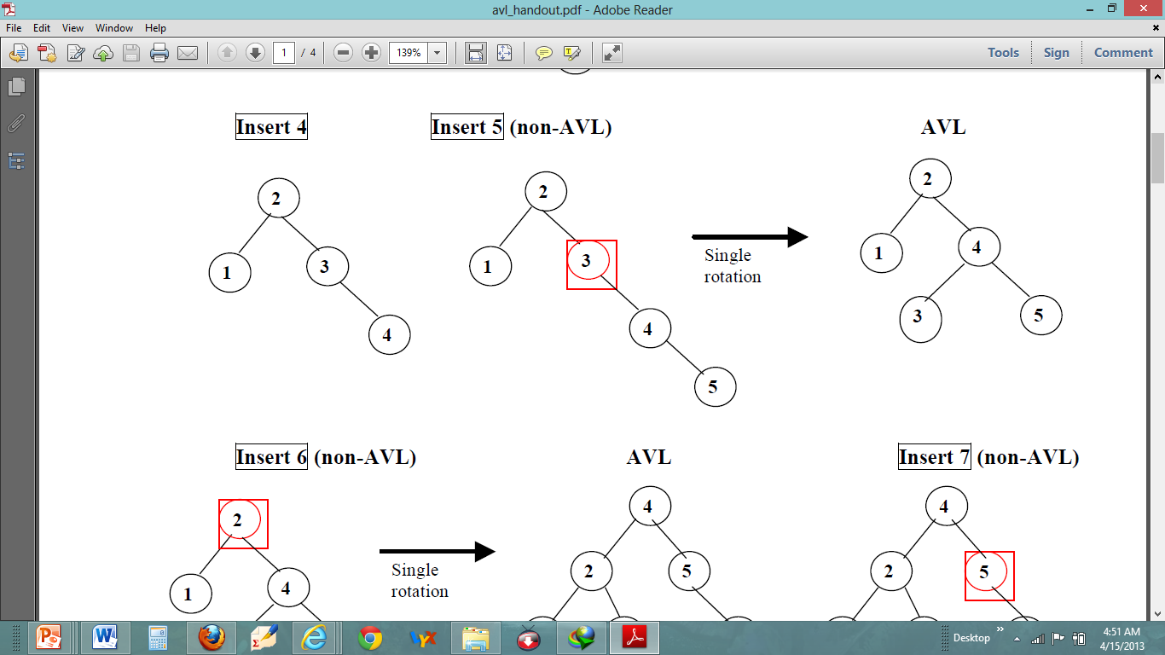

Slide 22
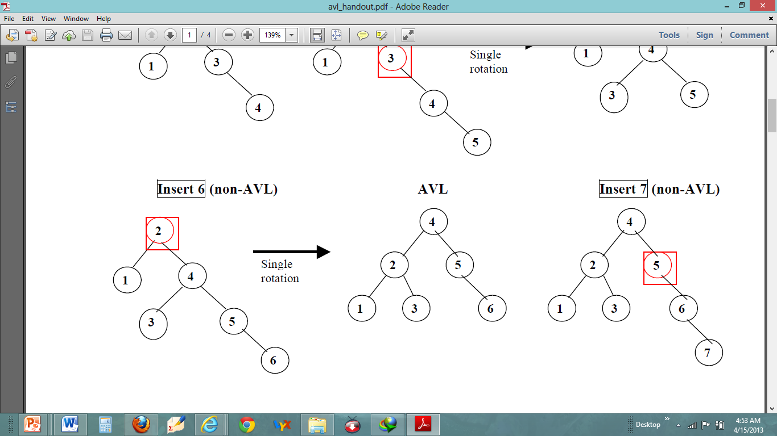

Slide 23
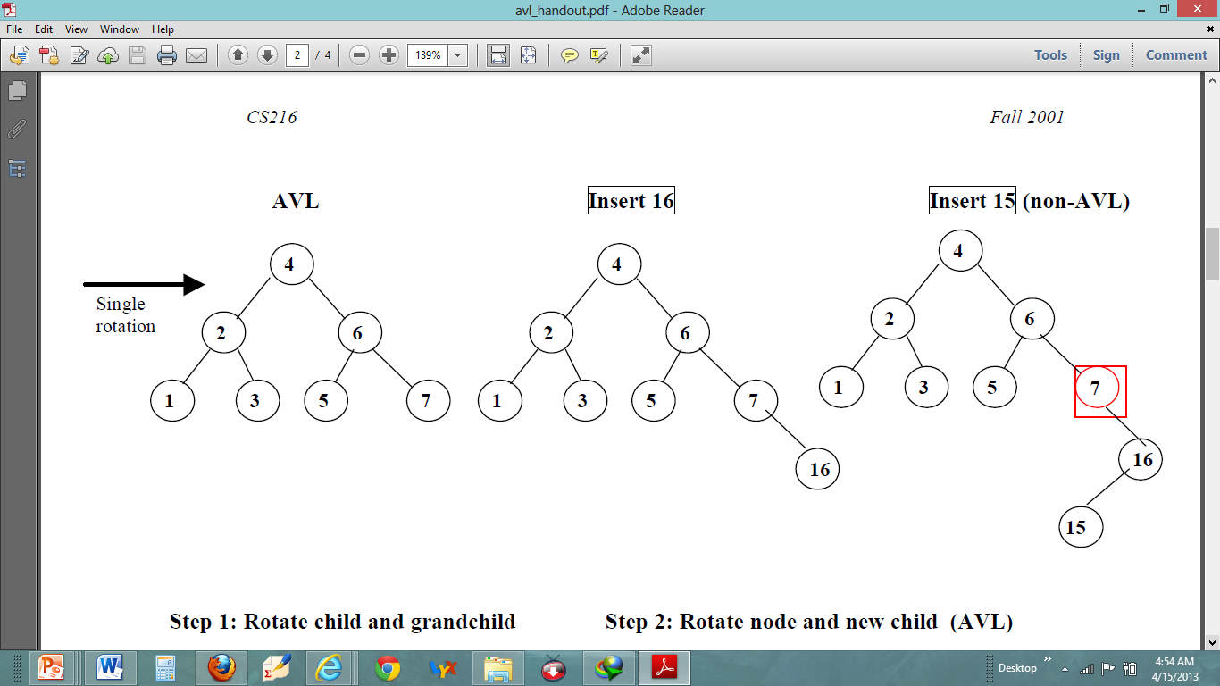

Slide 24
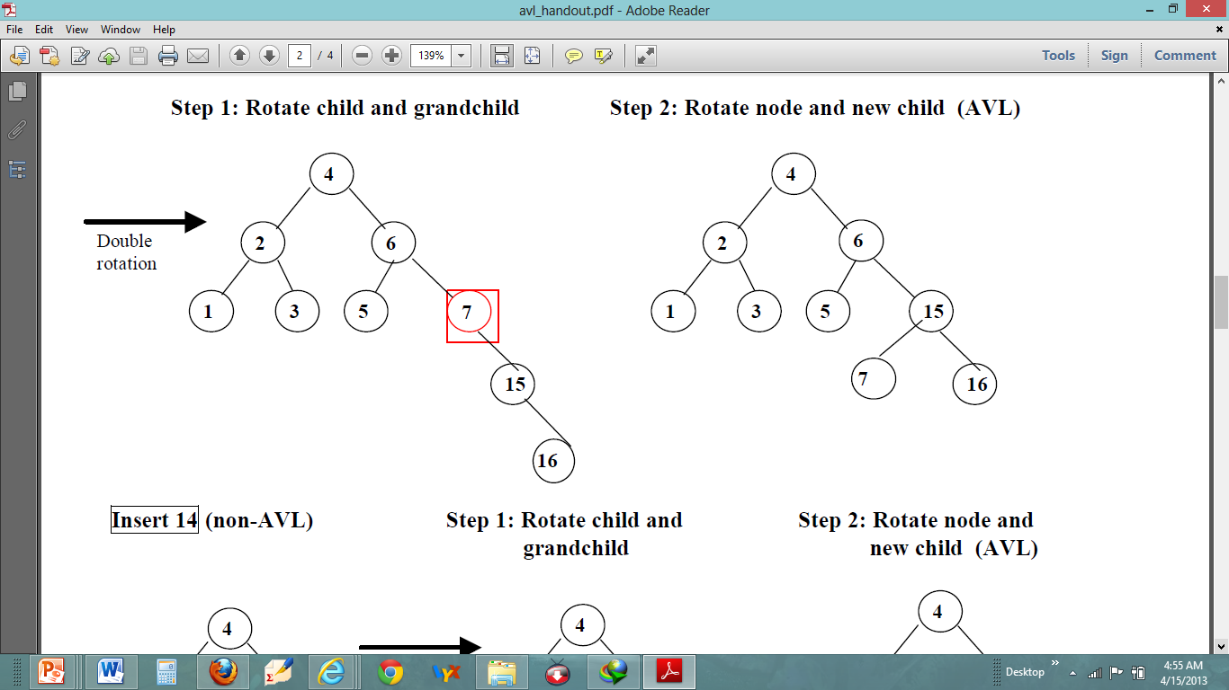

Slide 25
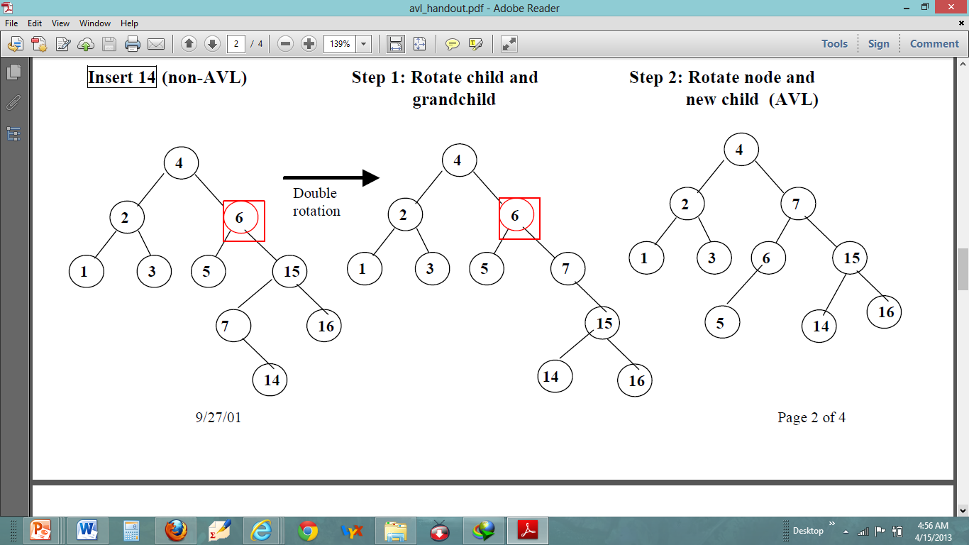

Slide 26
Another example: Initial AVL tree with balance factors:
Balance ok
0
57
0
26
+1
72
-1
25
0
38
0
63
-1
94
0
3
0
37
0
47
0
78
Next step: insert 1 -->

Slide 27
Insert 1 and recalculate balance factors
Balance not ok
(Balance factor of -2 is not allowed)
-1
57
-1
26
+1
72
-2
25
0
38
0
63
-1
94
-1
3
0
37
0
47
0
78
0
1
Next step: Find rebalancing case -->

Slide 28
Balance not ok
Find rebalancing case
-1
57
-1
26
+1
72
Left Left Case
-2
25
0
38
0
63
-1
94
Pivot
-1
3
0
37
0
47
0
78
0
1
Next step: apply Left Left rebalancing -->

Slide 29
Balance ok
Rebalance and recalculate balance factors
0
57
0
26
+1
72
0
3
0
38
0
63
-1
94
0
1
0
25
0
37
0
47
0
78
Next step: insert 30 -->

Slide 30
Balance ok
Insert 30 and recalculate balance factors
-1
57
+1
26
+1
72
0
3
-1
38
0
63
-1
94
0
1
0
25
-1
37
0
47
0
78
0
30
Next step: Insert 32 -->

Slide 31
Balance not ok
Insert 32 and recalculate balance factors
-2
57
+2
26
+1
72
0
3
-2
38
0
63
-1
94
0
1
0
25
-2
37
0
47
0
78
+1
30
0
32
Next step: Find rebalancing case -->

Slide 32
Balance not ok
Find rebalancing case
-2
57
+2
26
+1
72
0
3
-2
38
0
63
-1
94
0
1
0
25
-2
37
0
47
0
78
+1
30
Left Right Case
0
32
Next step: Rebalance (Step 1) -->

Slide 33
Balance not ok
Rebalance (Step 1)
-2
57
+2
26
+1
72
0
3
-2
38
0
63
-1
94
0
1
0
25
-2
37
0
78
0
47
-1
32
0
30
Next step: Rebalance (Step 2) -->

Slide 34
Balance ok
Rebalance (Step 2) and recalculate balance factors
-1
57
+1
26
+1
72
0
3
-1
38
0
63
-1
94
0
1
0
25
0
32
0
47
0
78
0
30
0
37
Next step: Insert 35 -->

Slide 35
Balance not ok
Insert 35 and recalculate balance factors
-2
57
+2
26
+1
72
0
3
-2
38
0
63
-1
94
0
1
0
25
+1
32
0
47
0
78
0
30
-1
37
0
35
Next step: Find rebalancing case -->

Slide 36
Balance not ok
Insert 35
-2
57
+2
26
Start from first spot (from bottom of tree) where balance factor is incorrect.
+1
72
0
3
-2
38
0
63
-1
94
0
1
0
25
+1
32
0
47
0
78
Left Right Case
0
30
-1
37
0
35
Next step: Rebalance (Step 1) -->

Slide 37
Balance not ok
Rebalance (Step 1)
-2
57
+2
26
+1
72
0
3
-2
38
0
63
-1
94
0
1
0
25
-2
37
0
47
0
78
0
32
0
30
0
35
Next step: Rebalance (Step 2) -->

Slide 38
Balance ok
Rebalance (Step 2)
-1
57
+1
26
+1
72
0
3
0
37
0
63
-1
94
0
1
0
25
0
32
+1
38
0
78
0
30
0
35
0
47
Next step: Finished! -->

Slide 39
Balance ok
Finished!
-1
57
+1
26
+1
72
0
3
0
37
0
63
-1
94
0
1
0
25
0
32
+1
38
0
78
0
30
0
35
0
47
Exercise: insert 36

Slide 40
Insertion Analysis
logN
Insert the new key as a new leaf just as in ordinary binary search tree: O(logN)
Then trace the path from the new leaf towards the root, for each node x encountered: O(logN)
Check height difference: O(1)
If satisfies AVL property, proceed to next node: O(1)
If not, perform a rotation: O(1)
The insertion stops when
A rotation is performed
Or, we’ve checked all nodes in the path
Time complexity for insertion O(logN)

Slide 41
Deletion Operation in AVL Tree
In an AVL Tree, the deletion operation is similar to deletion operation in BST. But after every deletion operation we need to check with the Balance Factor condition. If the tree is balanced after deletion then go for next operation otherwise perform the suitable rotation to make the tree Balanced.

Slide 42
Deletion from AVL Tree
Delete a node x as in ordinary binary search tree
Note that the last (deepest) node in a tree deleted is a leaf or a node with one child
Then trace the path from the new leaf towards the root
For each node x encountered, check if heights of left(x) and right(x) differ by at most 1.
If yes, proceed to parent(x)
If no, perform an appropriate rotation at x Continue to trace the path until we reach the root

Slide 43
As with insertions, a node can be deleted form AVL just like BST tree. But, just like insertion, deletion can cause an imbalance, which will need to be fixed by applying one of the four rotations.
For example, assume the following tree:

Slide 44
If we identify the parent of the actual node that was deleted, then:
If the left child was deleted, the balance factor at the parent increased by 1.
If the right child was deleted, the balance factor at the parent decreased by 1.
The change in balance factor can move up the tree from the deleted node's parent all the way to the root. Therefore, it's possible that a node's balance factor could become +2 or -2. If this happens, then balance needs to be restored.
Let A be the node where balance must be restored. If the deleted node was in A's right subtree, then let B be the root of A's left subtree. Then:
B has balance factor 0 or -1 after deletion -- then perform a single right rotation
B has balance factor +1 after deletion -- then perform a left-right rotation
If the deleted node was in A's left subtree, then let B be the root of A's right subtree. Then:
B has balance factor 0 or +1 after deletion -- then perform a single left rotation
B has balance factor -1 after deletion -- then perform a right-left rotation

Slide 45
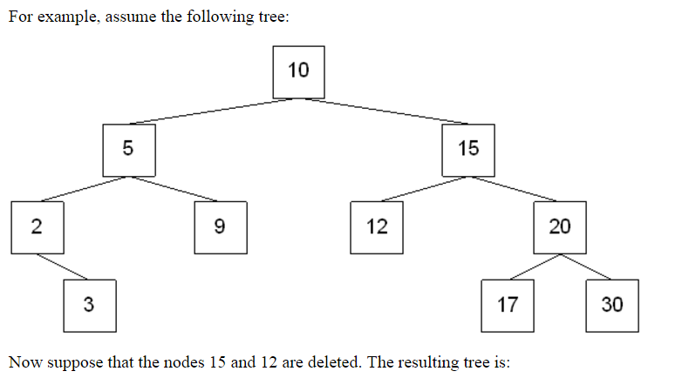

Slide 46

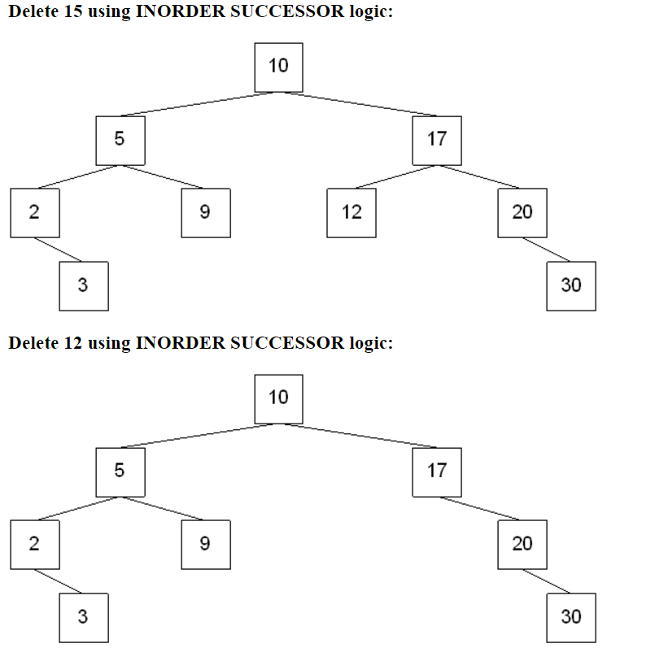
If the deleted node was in A's left subtree, then let B be the root of A's right subtree. Then:
B has balance factor 0 or +1 after deletion -- then perform a single left rotation
A
B

Slide 47
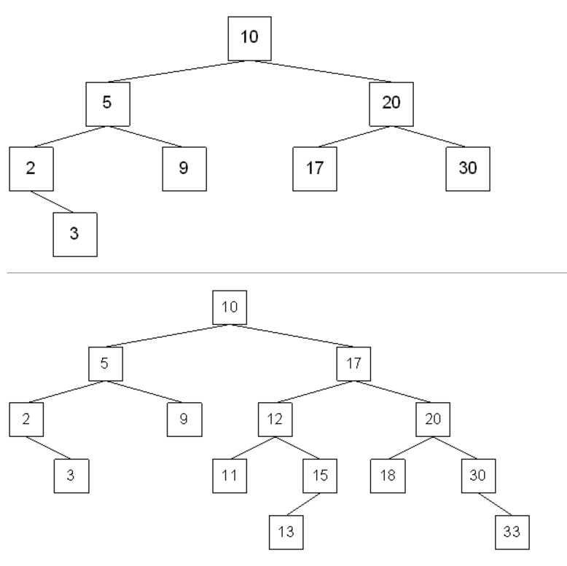

Slide 48
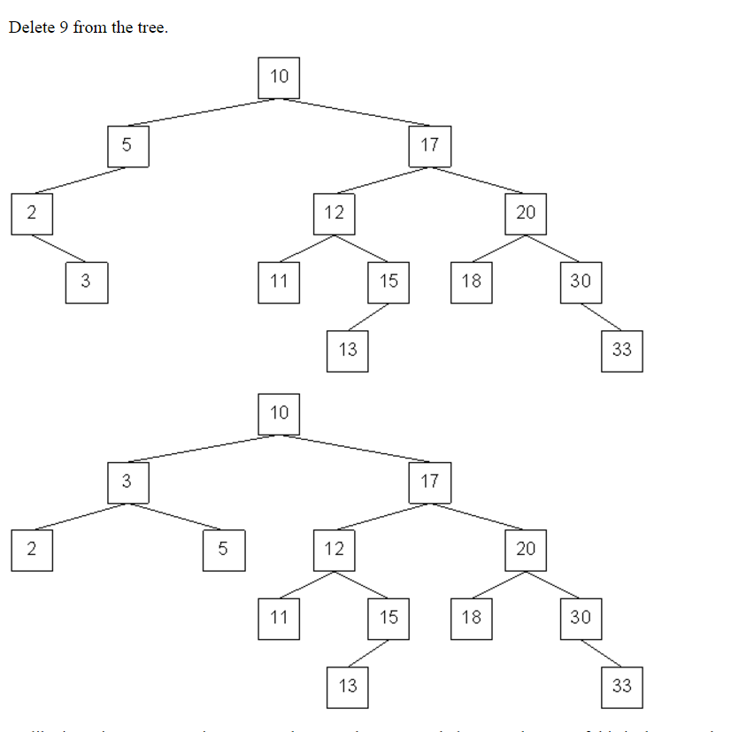
Let A be the node where balance must be restored. If the deleted node was in A's right subtree, then let B be the root of A's left subtree. Then:
B has balance factor +1 after deletion -- then perform a left-right rotation
A
B

